Slide 1
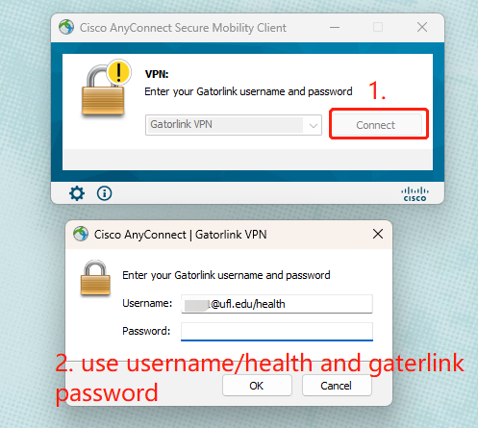
1. Download UF VPN
Connect VPN
https://it.ufl.edu/ict/documentation/network-infrastructure/vpn/
2. Connect UF Health VPN

Slide 2
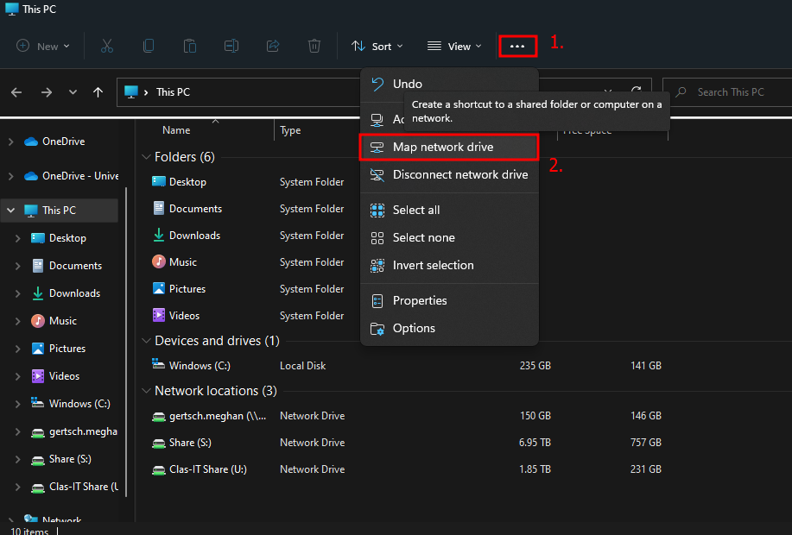
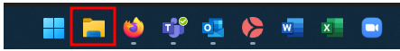
Method 1
Share Drive from Windows
Select This PC from the left pane. Then at the top of the File Explorer window, select the 3 dots icon. In the menu list, select “Map network drive”
Before setting up access to your drive, you must connect to the UF VPN.
Open Windows File Explorer by selecting the manila folder in the center of your taskbar

Slide 3
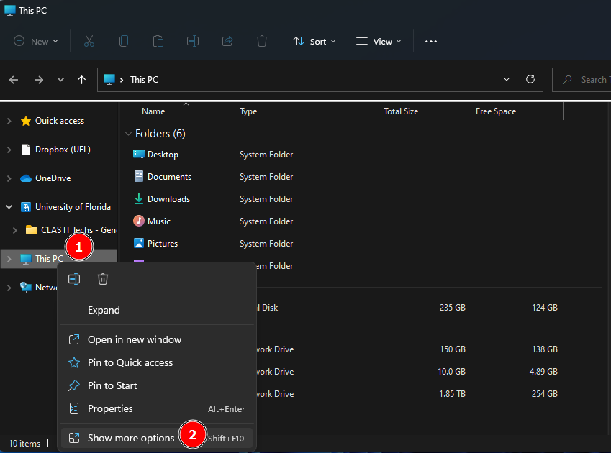
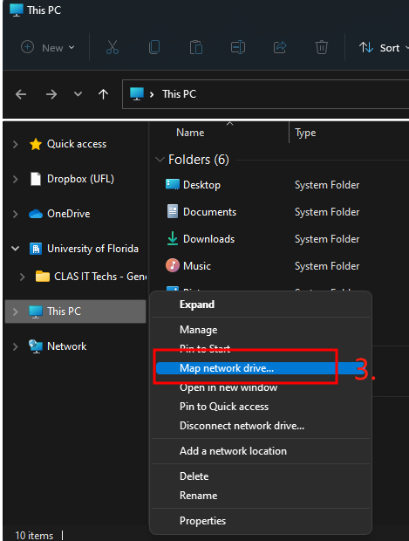
Share Drive from Windows
Method 2
In the pop-up menu, select “Show more options”. In the second pop-up menu, select “Map network drive…”

Slide 4
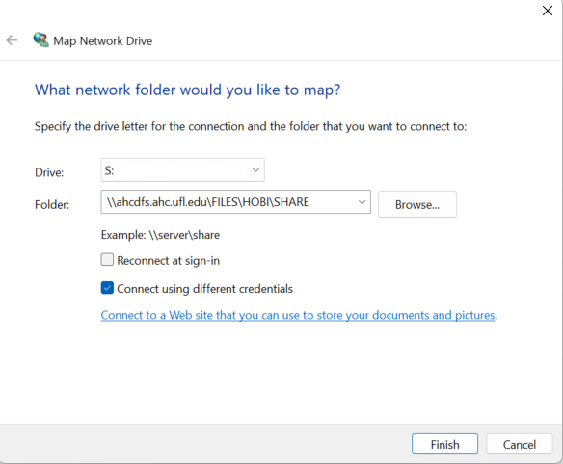
In the “Map Network Drive” window, please use the following:
Drive: S
Folder: \\ahcdfs.ahc.ufl.edu\FILES\HOBI\SHARE
Select the checkbox “Connect using different credentials”
Select Finish

Slide 5
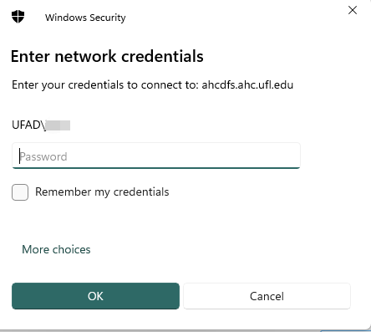
Enter your network credentials when prompted. Use the following:
Username: UFAD\gatorlink_username
Password: gatorlink_password
Select the checkbox “Remember my credentials” if you do not want to be prompted each time
If your credentials are accepted, you will see the contents of the Share drive and the drive listed in the left-hand panel

